Slide 1
Generative Modeling and Variational Auto-Encoders (VAEs)

Slide 2
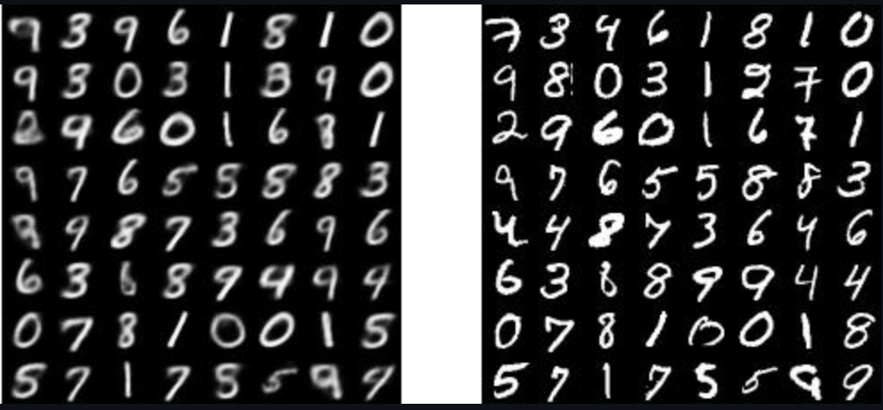


Unsupervised Learning: From observations (x) to latent variables (z), without labeled data
Observed variable: Because we see this data, both at training and at testing. This is what we sample. E.g. an image, or the vector representing a data point.
Latent variable: We do not know this information. Given x, we have to infer it.
z: label of digit, thickness, slope … x: image of digit
z: content, lighting angle, zoom … x: the photo
z: sentiment, vocabulary, grammar skills … x: written review

Slide 3
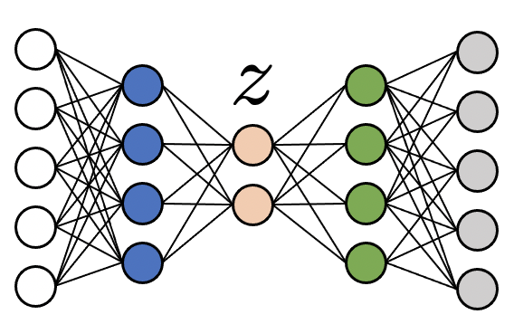
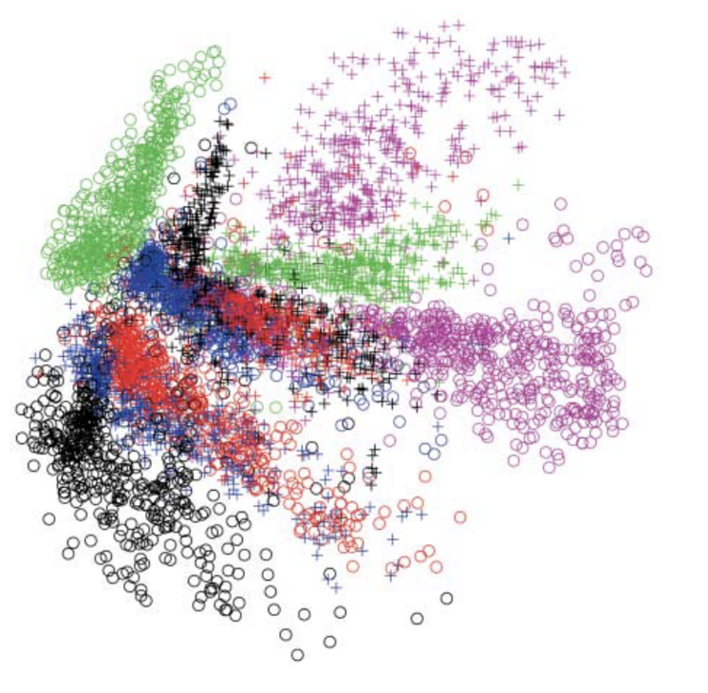
Standard (basic) Auto-Encoder
Motivation: Learn function (Encoder)
where representation z is hopefully useful.
Introduced (Decoder)
to enable training with reconstruction loss.
Ideal for encoding x to lower dimension (compression) and then decode.

Slide 4
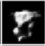
Problems generating new data with basic AE
Step 1: Sample random z
E.g. With uniform probability between [min, max] values z seen during training
Step 2: Decode
z from region with training samples
Realistic digit
Unrealistic digit / bad result
z from region without training samples
Basic AEs are not appropriate for image generation. Reconstruction loss does not train AE for generation.
We will see how Generative Models (VAEs and GANs) are trained appropriately for generation.
Problems:
No “real” digits were encoded in that area during training. Hence these z values do not encode “realistic” digits.
Decoder has not learned to decode such z values

Slide 5
Generative Models
Nice intro to Generative Modelling by David Foster: https://www.oreilly.com/library/view/generative-deep-learning/9781492041931/ch01.html

Slide 6
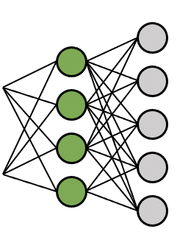
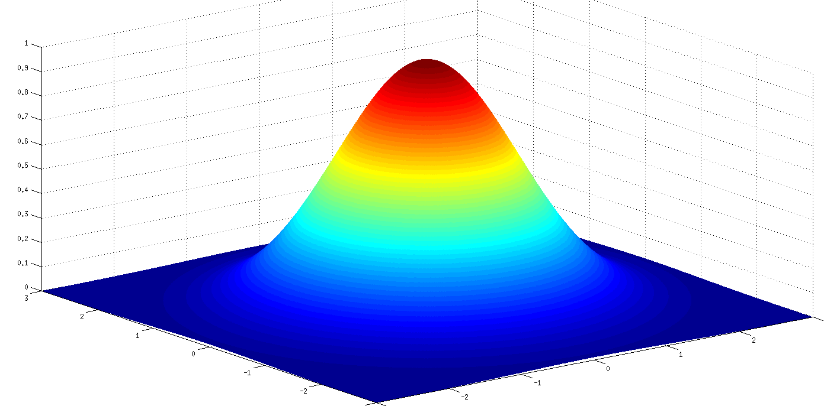
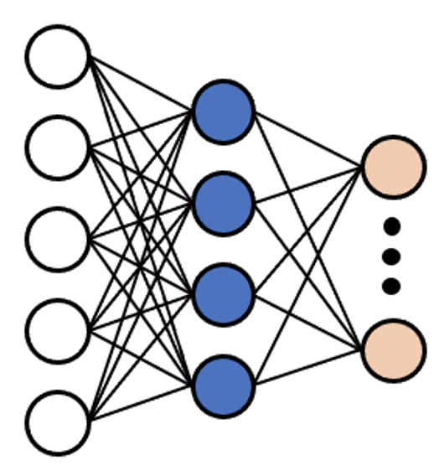
What is a Generative Model?
“A generative model describes how a dataset is generated, in terms of a probabilistic model.
By sampling from this model, we are able to generate new data.”
Generative Deep Learning, by David Foster
Prior distribution of z
Random sample
Generated new data point
Generative models:
We assume: z “causes” x
In contrast to: Recognition (discriminative) models:

Slide 7
Basic AEs: Learn to infer meaningful representation z of data
Given only input samples x, how to learn a meaningful encoding
This was the original motivation for the creation of Auto-Encoders
They are not trained / designed for generation (sampling) of new data points.

Slide 8
Generative Models: How to learn model of process that generates realistic samples?
(in unsupervised manner)
Generative models:
Prior distribution of z
Output must be realistic
sample
What is a training objective for learning such a model?
In the process, we will also “have” to learn a representation Z that encodes meaningful info about the data.
z “causes” x
“What I cannot create, I do not understand.”
Richard Feynman
z: content, lighting angle, zoom … x: the photo

Slide 9
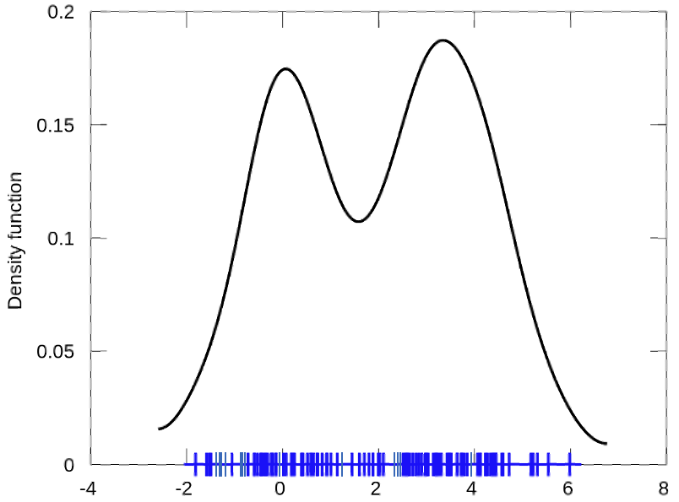
Probability Density Function (PDF) of data,
1-dimensional data:
Probability
Feature-1

Slide 10
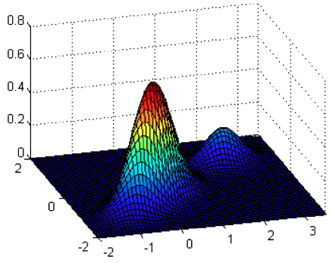
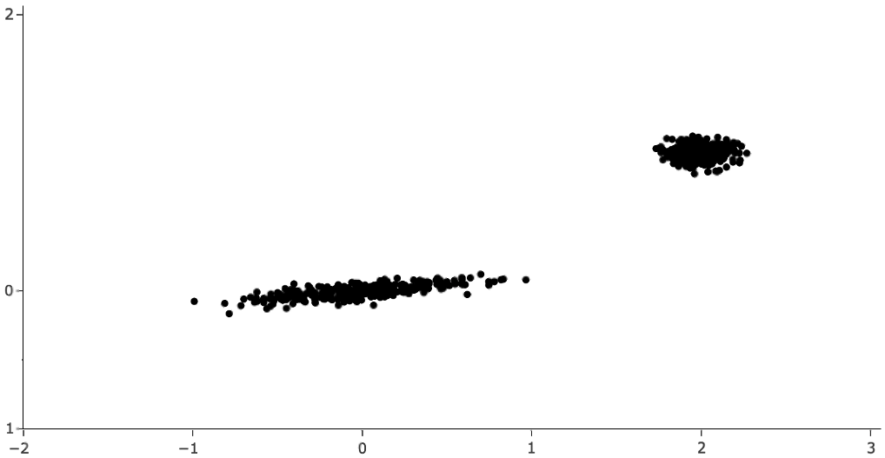
Probability Density Function (PDF) of data,
2-dimensional data:
Probability
Feature-2
Feature-1

Slide 11
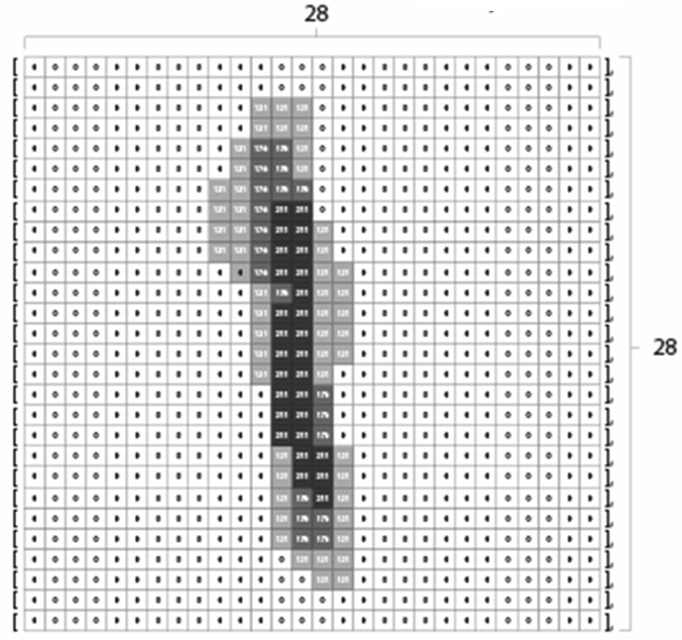
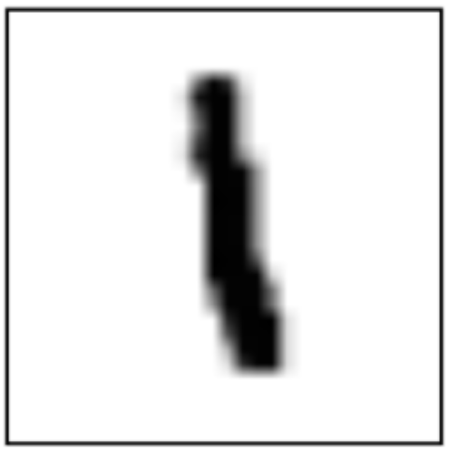
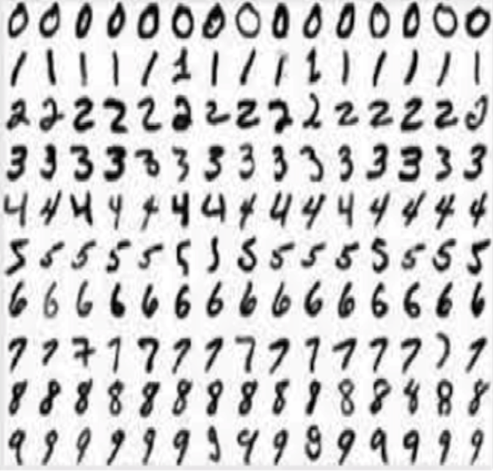
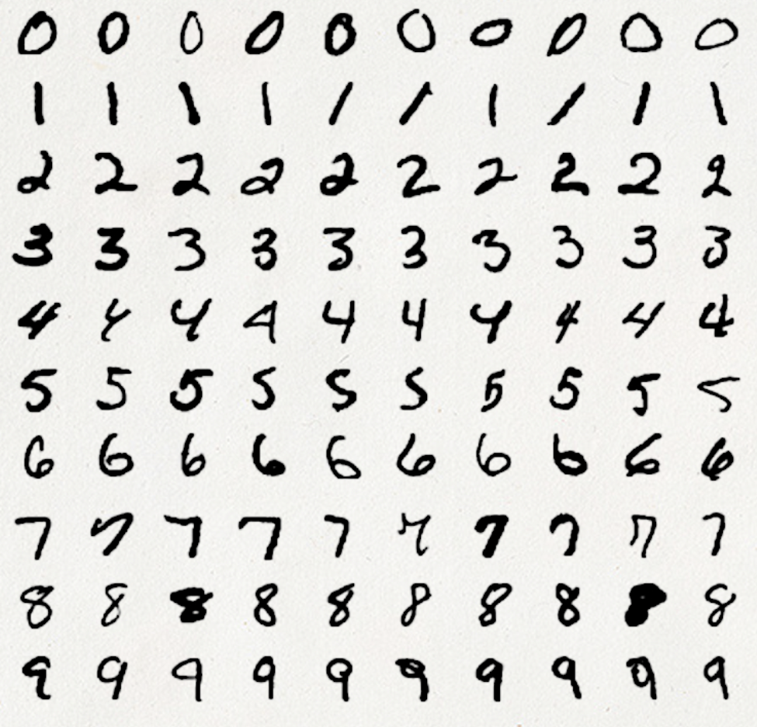
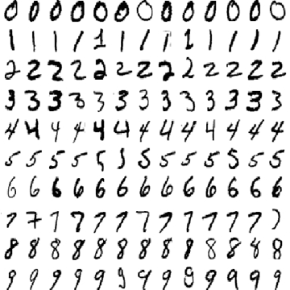
Probability Density Function (PDF) of data,
Multi-dimensional data:
MNIST: 28 x 28 = 784 features
Imagine a 784-dimensional space. Each image of MNIST digit is 1 point in that space.
Imagine all images of the MNIST database as points in that 784-d space.
The probability of (MNIST) data to exist in the area of the space at point x is

Slide 12
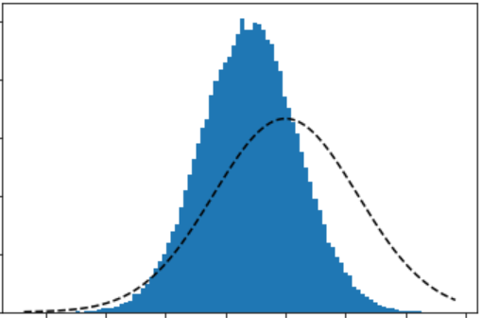
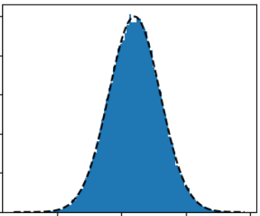
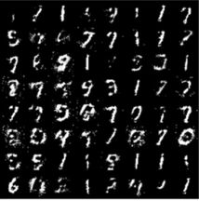
Gaussian
Probability Density Estimation
Histogram
One of the main aims of unsupervised approaches and Generative Modelling.
Goal of Density Estimation:
We could try to fit a probabilistic model to the data,
to learn their underlying distribution .
How? By learning its parameters so that:
But we cannot always do that directly.
Perhaps we cannot compute .
Instead, we could do PDE indirectly:
Enforce samples from model to be similar to real data instead:
Probability
Random sample
Feature-1
Both VAEs and GANs can be seen as following this approach.

Slide 13
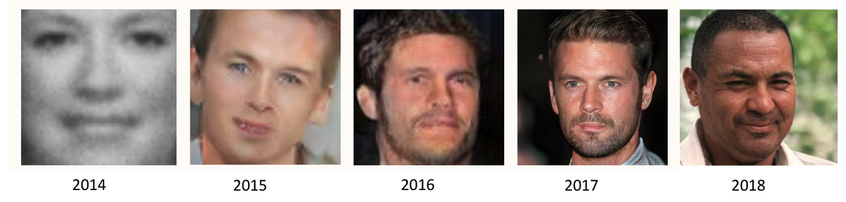
Great progress thanks to VAEs and GANs
From: Deep Generative Modelling, David Foster

Slide 14
We know what we want to do now to learn a Generative model (probability density estimation)
1. With what model? 2. How to train it?
Next video lecture: Variational Auto-Encoders

Slide 15
Thank you very much

